Slide 1
Setting the Stage: Workshop Framing and Crosscutting Issues
Simon Hearn, ODI
Evaluation Methods for Large-Scale, Complex, Multi-National Global Health Initiatives, Institute of Medicine
7-8 January, London, UK

Slide 2
What do we mean by complex interventions?
The nature of the intervention:
Focus of objectives
Governance
Consistency of implementation
How it works:
Necessariness
Sufficiency
Change trajectory
Photo: Les Chatfield - http://www.flickr.com/photos/elsie/
Notes:
Focus – Are the objectives defined or emergent objectives?
Involvement– Is there clear governance or is it flexible and shifting?
Consistency – Is there a standard delivery or does it adapt in context?
Necessariness – is the intervention the only way to achieve the intended impacts? And is it possible to know all other pathways?
Sufficiency – can the intervention produce the intended impacts by itself? And if not, can we predict the external factors required?
Change trajectory – What is the relationship between inputs and outcomes, and how does it change over time?

Slide 3
What are the challenges of evaluating complex interventions?
Describing what is being implemented
Getting data about impacts
Attributing impacts to a particular programme
Photo: Les Chatfield - http://www.flickr.com/photos/elsie/
Notes:
We’re here to discuss practice of designing and conducting particular types of evaluations: mixed-method evaluations of large, complex interventions. But what makes these different? What do we especially need to pay attention to? I want to suggest three challenges that we might like to reflect on during the sessions in these two days:
Perhaps your main challenge with these types of evaluations is being able to describe what is being implemented, when it varies across multiple sites, programme components and over time? Developing a meaningful programme theory for a complex intervention is no mean feat.
Perhaps your main challenge is being able to get data about what impacts have been achieved, given time lags before they become evident? Our tried a tested toolkits are being stretched to their limits.
Or maybe it’s being able to attribute the impacts to a particular program, or the activities of particular partners, given the multiple factors affecting impacts? Perhaps where statistically valid counterfactuals are not possible.

Slide 4
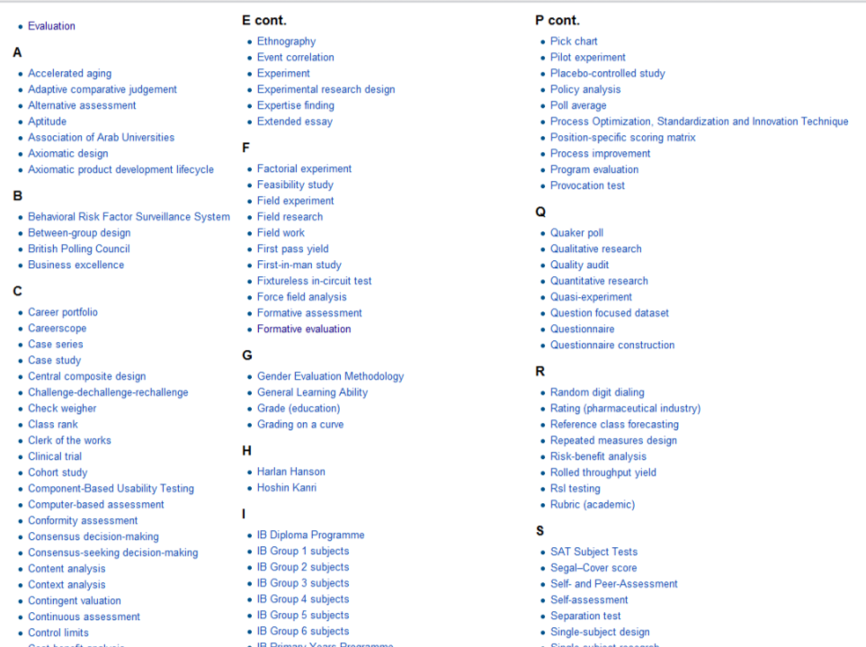
Why a framework is needed
Wikipedia: Evaluation Methods
Notes:
There are a vast number of evaluation methods in the toolboxes of evaluators, researchers and managers.
However, when development agencies or NGOs or in-country governments start to plan an evaluation, or to engage an evaluator, it is difficult to find accessible, comprehensive and credible information about how to choose the right combination of evaluation methods, and how to implement them well – or how to manage these issues with a potential evaluator.
Many guides to evaluation focus on only a few types of data collection methods and a few types of research designs. Usually missing are newer types of data collection (such as GIS logging on mobile phones, or tracking social media mentions), designs and strategies that can be used when experimental or quasi-experimental research designs are not feasible or appropriate, and methods to address issues such as clarifying and negotiating the values that should underpin the evaluation. There is information about some of these available on various web sites, but they can be difficult to locate, of varying quality, and not co-ordinated.
So we are either bamboozled by the massive range of options or…

Slide 5
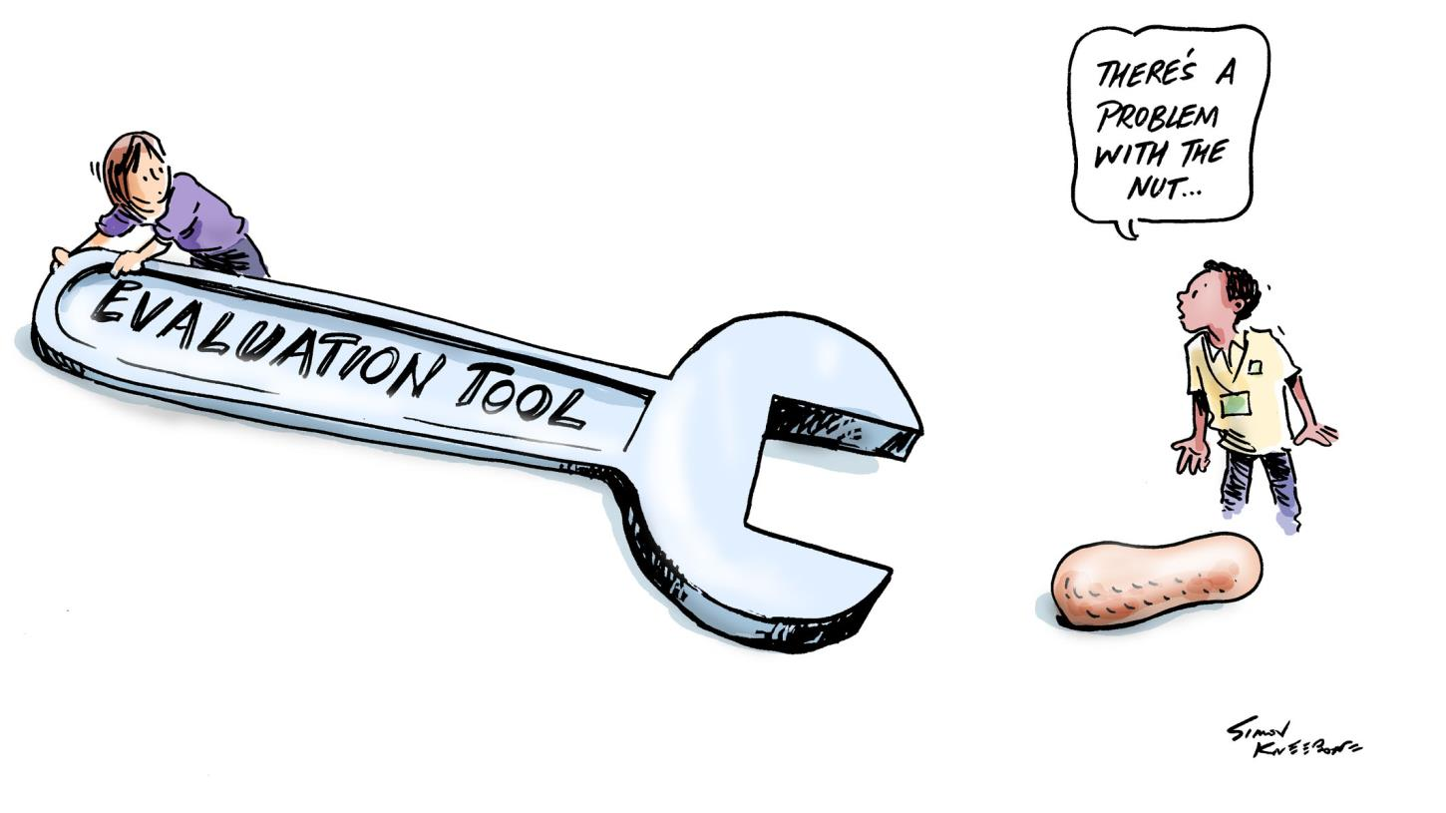
Why a framework is needed
Image: Simon Kneebone. http://simonkneebone.com/
Notes:
We stick to what we know, which can have alarming consequences, especially for complex evaluations where you really have to examine the nut you are dealing with before deciding on the tool to use.

Slide 6
The Rainbow Framework
Notes:
What we have found useful is to distinguish between different tasks in evaluation, which need different types of methods or processes. We have developed the Rainbow Framework which sets out seven clusters of tasks.
An evaluation starts by engaging stakeholders – those people who need to be involved in the decision making about an evaluation. This is part of MANAGING an evaluation. The next step is to describe the program - setting the boundaries and articulating its theory of change. This is part of DEFINING what is to be evaluated. The next step is to focus the evaluation design. We have found it is useful to separate this into two clusters of tasks. FRAMING the evaluation sets the boundaries of the evaluation - making decisions about its purposes, the primary intended users, the key evaluation questions, and the money, time and other resources available. Then the design of the evaluation sets out how data will be collected and analysed to answer three different types of questions – questions that require DESCRIPTION of what has happened, questions that require methods so we can UNDERSTAND the CAUSES of what has happened, and questions about the overall SYNTHESIS of the value of the program. Finally there are methods and processes to report and support use of findings. While this process often comes at the end of the evaluation, it should be planned from the beginning.

Slide 7
DEFINE what is to be evaluated

Slide 8
Why do we need to start with a clear definition?
Photo: Hobbies on a Budget / Flickr
Notes:
Developing an agreed definition of what is being evaluated is important to establish common understanding & identify any disagreements or gaps which can lead to problems later
- What is it that we are evaluating? The apples or oranges or the whole basket?
For complex interventions, a good description identifies whether there are multiple components, multiple levels of activity, multiple stakeholders and multiple intended impacts – and whether there are emergent aspects such as strategies and goals that will emerge as a better understanding of the situation and possibilities is developed.

Slide 9
Develop initial description
Develop program theory or logic model
Identify potential unintended results
Notes:
There are three important tasks involved in defining what is to be evaluated:
To develop an initial description – what is to be evaluated?
To develop a program theory or logic model – what are the intended outcomes and impacts – and how will the program help to bring them about?
And to also identify potential unintended results – so the evaluation can address these as well and take these into account in the overall judgement of success.

Slide 10
Options for representing logic models
Pipeline / results chain
Logical framework
Outcomes hierarchy / theory of change
Realist Matrix
Notes:
Logic models, or theories of change, are increasingly popular in evaluation. But many of them are little more than a list of program activities and intended impacts with arrows in between. A good logic model actually has a theory of change – how is change understood to come about – and a theory of action – how will the program activate this theory of change?
For complex interventions, a simple linear pipeline or results chain or logical framework is unlikely to be sufficient to show the layers of activities and impacts, the multiple contributors and emergent elements. Instead outcomes hierarchies or realist matrices are more likely to be useful.

Slide 11
FRAME what is to be evaluated
Notes:
The second cluster of tasks in an evaluation relate to framing the evaluation

Slide 12
Frame Decision
Make Decision
Frame Evaluation
Design Evaluation
Source: Hobbies on a Budget / Flickr
Notes:
The idea of framing an evaluation draws on research into decision making which found that effective decision makers don’t rush to make the decision,
..but stop to frame it. They make sure they are clear about what needs to be taken into account, including who needs to be involved in making the decision, and when it is needed.
With evaluation, there is often pressure to rush to design an evaluation – to choose metrics or a research design.
.. But it is important to frame it, to be clear about what needs to be taken into account when designing it – and in particular to be clear about the intended uses of the evaluation.

Slide 13
Identify primary intended users
Decide purpose(s)
Specify key evaluation questions
Determine what ‘success’ looks like
Notes:
There are four tasks in framing that need to be addressed before you can design an evaluation. The first two are related – who is this evaluation for? And how are they going to use it?
The first two tasks are interconnected and where you start will vary. Sometimes the primary intended users have already been identified, and the next task is to identify how they intend to use the evaluation. Other times the purpose of the evaluation has been identified and the next task is to identify the primary intended users. For example if an evaluation is being conducted to improve how a program is working, we should identify who would make decisions about changing the way things are done, and would therefore be the intended users.
From this comes the third task – specifying key evaluation questions – descriptive, causal, synthesis, action
And the fourth one is about values – determining what success looks like. Processes, outcomes, costs & benefits. Standards and criteria.
For complex interventions, with multiple contributors, there are likely to be multiple primary intended users of an evaluation with different purposes. They may have different key evaluation questions and different ideas about what ‘success’ will look like. They might decided to undertake separate evaluations, or to develop a joint evaluation which acknowledges their different information needs and values.

Slide 14
DESCRIBE what happened

Slide 15
Sample
Use measures, indicators or metrics
Collect and/or retrieve data
Manage data
Combine qualitative and quantitative data
Analyze data
Visualize data

Slide 16
Combine qualitative and quantitative data
Enrich
Examine
Explain
Triangulate
Parallel
Sequential
Component
Integrated
Notes:
Combining qualitative and quantitative – a topic very pertinent to this workshop.
Very much a juggling act.
Be very clear about purpose – why combining?
Enrich quant with qual.
Examine hypothesis from qual with quant.
Explain unexpected quant results with qual.
Triangulate results to verify or reject.
When gathering data:
Parallel Data Gathering: gathering qualitative and quantitative data at the same time.
Sequential Data Gathering: gathering one type of data first and then using this to inform the collection of the other type of data.
When combining data:
Component design: collecting data independently and then combining at the end for interpretation and conclusions.
Integrated design: combining different options during the conduct of the evaluation to provide more insightful understandings.

Slide 17
UNDERSTAND CAUSES of outcomes and impacts

Slide 18
Outcomes
Impacts
Notes:
The definition of Outcomes and Impacts differ in different sectors but they generally refer to the same thing: things that happen (to people or communities, or the environment, etc) as a result of the project, program, policy, or whatever you are evaluating.
If we’re not attempting to understand what caused the outcomes or impacts then all we are doing is documenting coincidences and we can’t really call them outcomes or impacts at all.
In all outcome and impact evaluation we must deal with causation.

Slide 19
As a profession, we often either oversimplify causation or we overcomplicate it!
Notes:
I think we can, as a profession, often fall into two traps:
massively oversimplifying causation
and massively overcomplicating it.
On oversimplification, there’s often an implicit assumption that if the expected changes occur, they must have been caused by the program.
So, the evaluation just documents those and calls them outcomes without actually checking that they are.
But we also have a tendency to overcomplicate. A lot of people seem to think that the only way to infer causation is with elaborate experimental designs, very large datasets, and sophisticated statistical techniques. And if you can’t do that, then you just throw your hands in the air and say well, we can’t really be sure that any of these were influenced by the program.
Experimental designs can indeed be very powerful, and the BetterEvaluation site has some good advice on when to choose this option and how to use it well.
But experimental designs are not the be-all and end-all of causal inference.
The BetterEvaluation site has several non-experimental options which can offer sufficient rigour with a straight forward design.

Slide 20
“In my opinion, measuring attribution is critical, and we can't do that unless we use control groups to compare them to.”
Comment in an expert discussion on The Guardian online, May 2013

Slide 21
Check that the results support causal attribution
Compare results to the counterfactual
Investigate possible alternative explanations

Slide 22
SYNTHESIZE data from one or more evaluations
Notes:
Synthesis is part of the BetterEvaluation framework –This cluster looks at ways of answering synthesis questions – the overall evaluative questions that bring together data and values to make evaluative judgements about whether something is working well or not.
Some level of synthesis is essential for all evaluations yet it’s often missed out of evaluation designs.

Slide 23
Was it good? Did it work?
Was it effective?
For whom did it work?
In what ways did it work?
Was it value for money?
Was it cost-effective?
Did it succeed in terms of the Triple Bottom Line?
Notes:
The synthesis questions would be our main focus. We would want to ask questions such as “Was it good? Did it work? Was it effective?”. In many evaluations, just looking at the average effect would not be enough. If we are concerned about equity, we would want to know “For whom did it work?”. If it worked in terms of some criteria but not others, we’d want to know this too.
And in many cases we’d want to relate this performance data to costs. Was it value for money? Was it cost-effective? Did it succeed in terms of the Triple Bottom Line – social costs and benefits, economic costs and benefits and environmental costs and benefits.
To answer these questions we need to draw on the answers to other types of questions – value questions about what success looks like, descriptive questions about what has happened, and causal questions about what has caused things to happen – but we need more than this. We need synthesis methods.

Slide 24
How do we synthesize diverse evidence about performance?
All intended impacts achieved | ✓ | ✗ | ✗ | ✗
Some intended impacts achieved |  | ✓ | ✓ | ✗
No negative impacts | ✓ | ✓ | ✗ | ✗
Overall synthesis | GOOD | ?? | ?? | BAD
Notes:
Let’s think about some different scenarios. In some of them, synthesis is easy.
In the first scenario, shown in the first column, all the intended impacts were achieved, and there were no negative impacts. If the intended impacts reflect the actual needs, then it’s easy to conclude that this has been a successful program.
In the last scenario, none of the intended impacts were achieved, and there were negative impacts, so it’s easy to conclude this has been a bad program.
But what about when the results are mixed? If some of the intended impacts were achieved, but not all of them, should we consider this a success? Or if they were achieved for some people in the target group but not all?
Or what if some of the intended impacts were achieved but there were also some negative impacts? What if the program helped some people but was harmful for some others in the target group?
We need some strategies for micro, meso and macro synthesis:
Micro-level synthesis looks at performance on key dimensions and will help us to move beyond assessments like ‘intervention met target’ – is that a good result? Is it good enough?
Meso-level synthesis then weighs up these individual assessments to help navigate through a mixture of successes and disappointments and to use all the dimensions to answer the evaluation questions.
Macro-level synthesis is only required when there is an overall questions about the merit or worth of an intervention – was it worthwhile, was it value for money?
This is where the options under this task might be appropriate.
One strategy you might be familiar with is numeric weighting, where each criteria is allocated a number of points, and each project, or option, is rated on each criteria, with the scores being added up for the total score.
But there are other options which might be more appropriate. The BetterEvaluation site has some great resources on developing and using rubrics, or global assessment scales, in a participatory way to ensure that the evaluative judgements are seen as informed and legitimate. We also have a detailed case showing how these were used in an evaluation.

Slide 25
Synthesize data from a single evaluation
Synthesize data across evaluations
Generalize findings
Notes:
As well as sythesizing data from a single evaluation, we can also synthesize data across evaluations which can help answer questions like: does this type of intervention work? Which variations are more effective and when?

Slide 26
REPORT and SUPPORT USE of findings

Slide 27
I can honestly say that not a day goes by when we don’t use those evaluations in one way or another
Notes:
How can evaluation make a difference?
How do you move from a situation where evaluations are published but just sit on the shelf – or worse, perhaps they are misused as they are in this cartoon – where you can see that evaluation reports are used to prop the desk up and hold the window open.
How do we move from this, to a situation where they contribute to improved social conditions? – which I think most of us believe evaluation should do.

Slide 28
Identify reporting requirements
Develop reporting media
Ensure accessibility
Develop recommendations
Support use

Slide 29
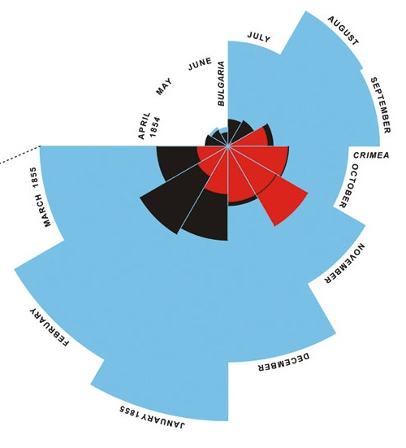
Notes:
One of my favourite infographics is from the 1850s by Florence Nightingale, who as well as being the grandmother of modern nursing, was also a keen statistician and she drew this graphic. It depicts the causes of death in the British Army in 1854. The graph shows that by far the biggest killer was preventable disease, not battle wounds as was previously thought. The data was so compelling that it contributed to a policy to improve the conditions in all military hospitals. Pretty impressive for a diagram.

Slide 30
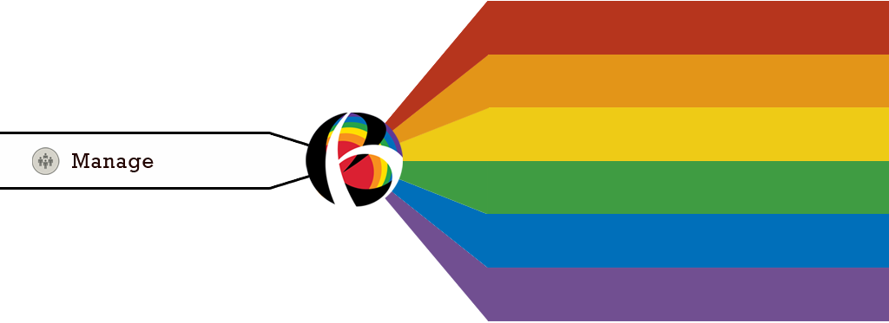
MANAGE your evaluation
Notes:
The tasks in this cluster are relevant throughout the entire process of the evaluation, through each of the previous tasks – which is why we chose to brand it as white, like the light in a prism.

Slide 31
Understand and engage with stakeholders
Establish decision making processes
Decide who will conduct the evaluation
Determine and secure resources
Define ethical and quality evaluation standards
Document management processes and agreements
Develop evaluation plan or framework
Review evaluation
Develop evaluation capacity
Notes:
Better Evaluation breaks the management of an evaluation into 9 key tasks. First, the manager of an evaluation needs to understand and engage with stakeholders, establish decision making processes, decide on the contributors to the evaluation, determine and secure resources, define the ethical and quality evaluation standards to be employed in the evaluation, document the process and ensure there is a clear evaluation plan or framework within which the evaluation rests.
The last two tasks are the hallmark of well managed and quality evaluations are evaluations that evaluate themselves against these tasks and that serve to also build evaluation capacity.

Slide 32
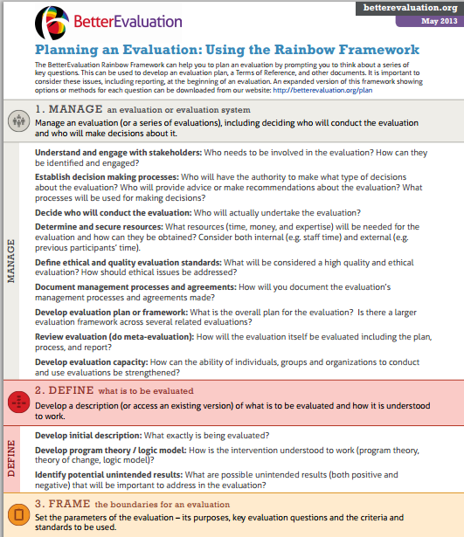
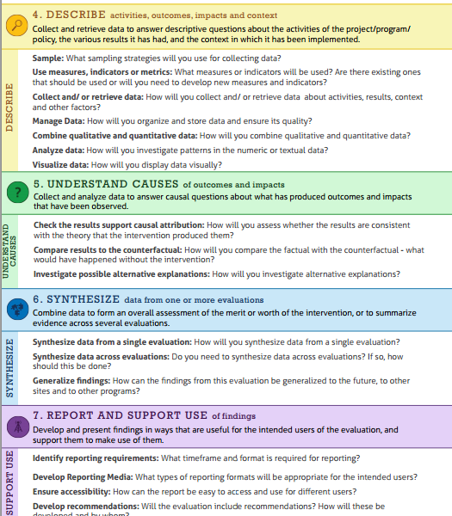
Notes:
I hope you find the framework useful in our discussions here today – and in your work afterwards.
I have handouts which provide two versions of the framework – an overview of the tasks, and a detailed version which lists different methods and processes you can use for each task.

Slide 33
Making decisions
Look at type of questions
DESCRIBE
Descriptive Questions – Was the policy implemented as planned?
UNDERSTAND CAUSES
Causal questions – Did the policy change contribute to improved health outcomes?
SYNTHESIZE
Synthesis questions – Was the policy overall a success?
REPORT & SUPPORT USE
Action questions – What should we do?
Notes:
Your Evaluation Plan will specify how you will collect and analyse data. It is useful to plan your data collection and analysis around a few Key Evaluation Questions. These are high level questions that the evaluation is intended to answer (for example, "How effective was the program?").
You will need different types of options for different types of evaluation questions:

Slide 34
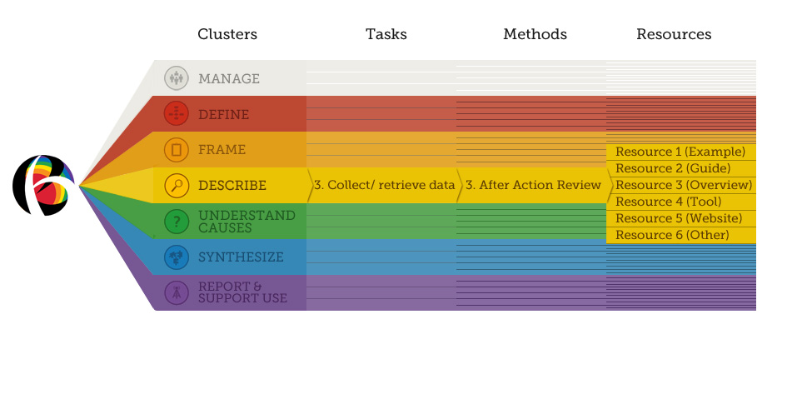
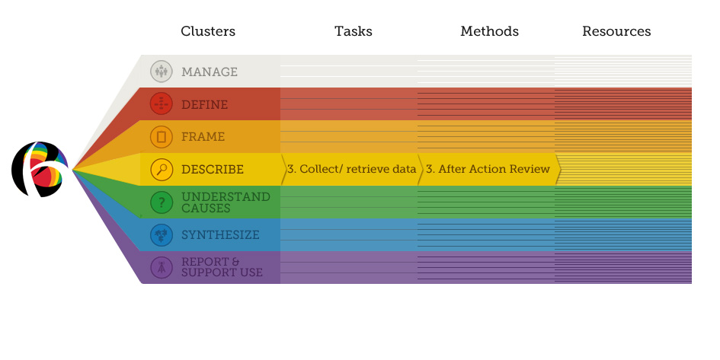
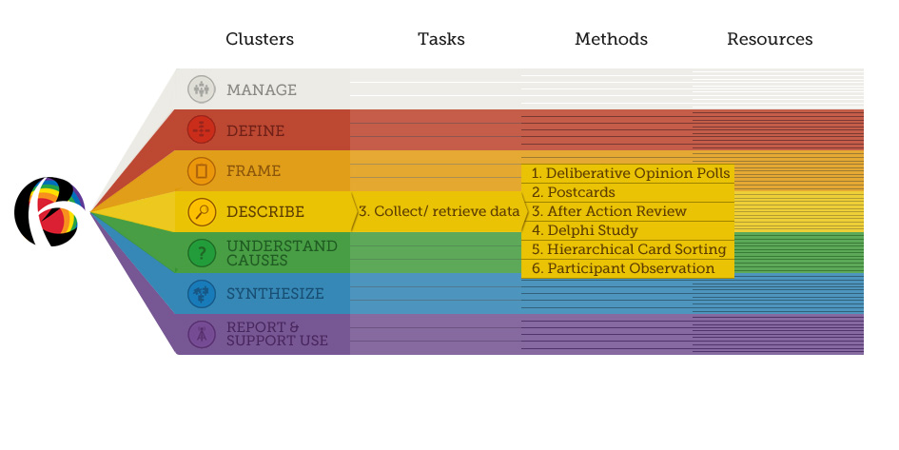
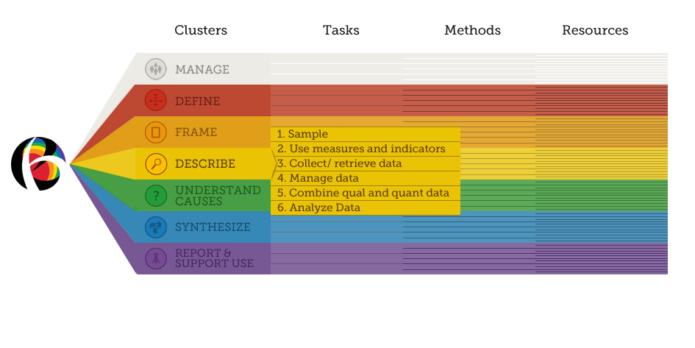
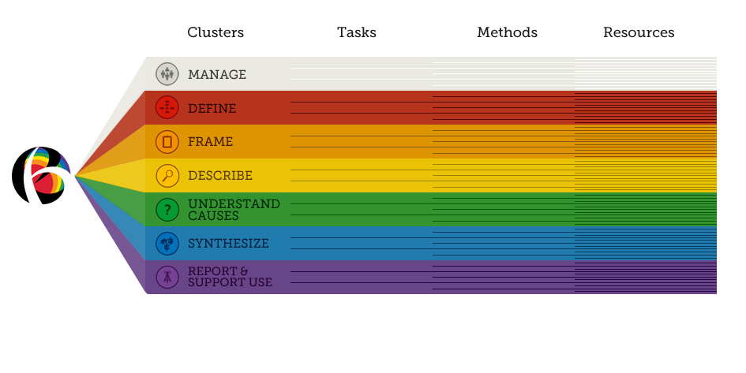
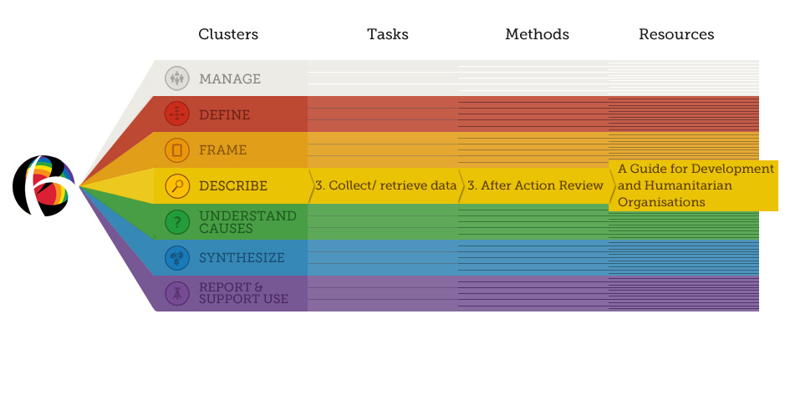
Making decisions
Compare pros and cons
Notes:
For each evaluation task you will find a range of options, each with their own advantages and disadvantages.
On each option page, you will find advice about when it might be appropriate to choose that option, taking into account available time, expertise and other issues.

Slide 35
Making decisions
Create an evaluation matrix
 | Participant Questionnaire | Key Informant Interviews | Project Records | Observation of program implementation
KEQ1 What was the quality of implementation? | ✔ | ✔ | ✔ | ✔
KEQ2 To what extent were the program objectives met? | ✔ | ✔ | ✔
KEQ3 What other impacts did the program have? | ✔ | ✔
KEQ4 How could the program be improved? | ✔ | ✔ |  | ✔

Slide 36
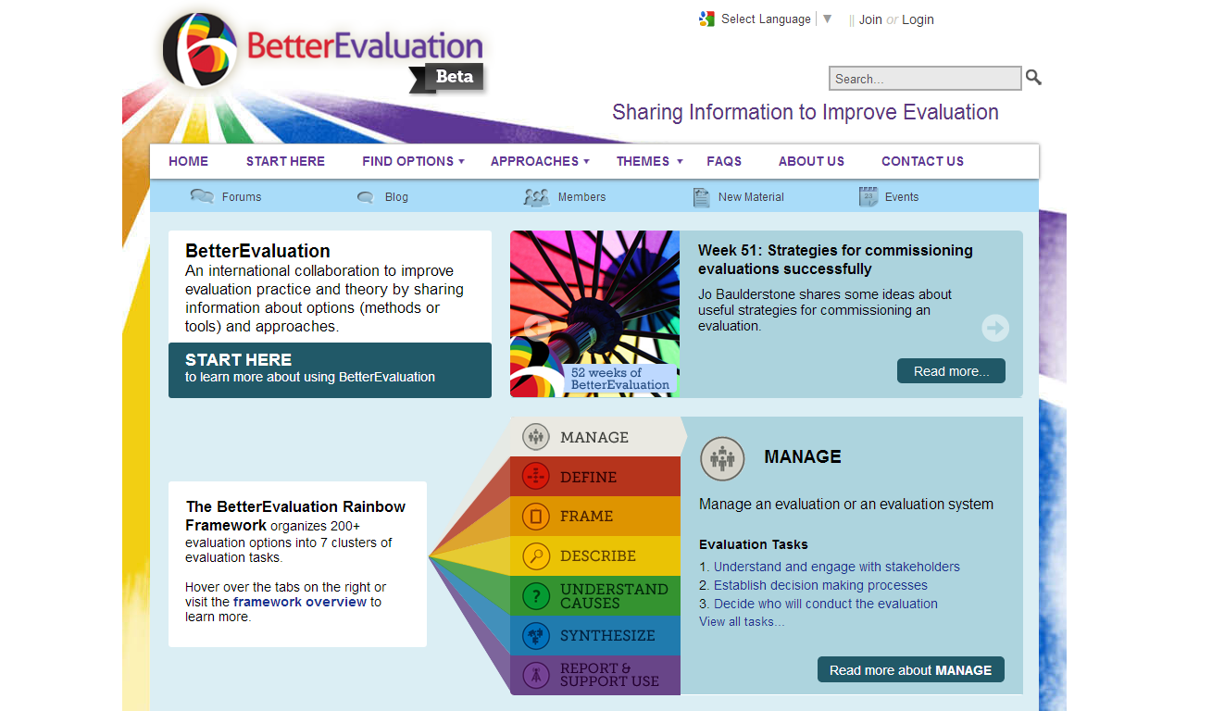
www.betterevaluation.org
Notes:
www.betterevaluation.org

Slide 37
Documenting
Sharing
activities
R & D
Events
Descriptions
WEBSITE
Comments
Examples
Guides
Tools
Notes:
The BetterEvaluation project provides a platform for sharing information about evaluation methods to improve evaluation practice and theory.
It consists of a website that provides information about how to choose and implement the appropriate combination of evaluation methods and a community that generates information about evaluation methods by sharing existing knowledge, documenting tacit knowledge, providing feedback, and undertaking research and development on evaluation methods.

Slide 38
Founding Partners
Financial Supporters

Slide 39
For more information:
www.betterevaluation.org/getting-started

